Slide 1


Slide 2
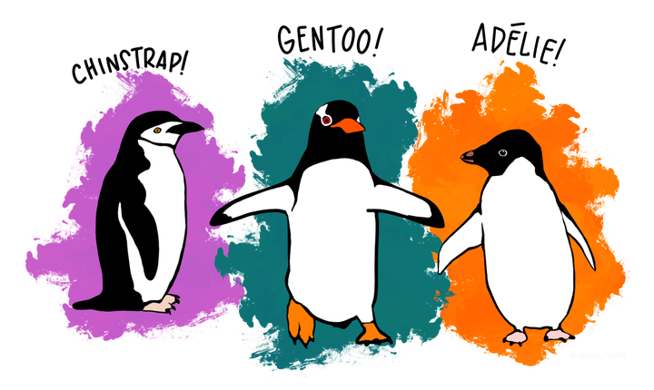


Slide 3
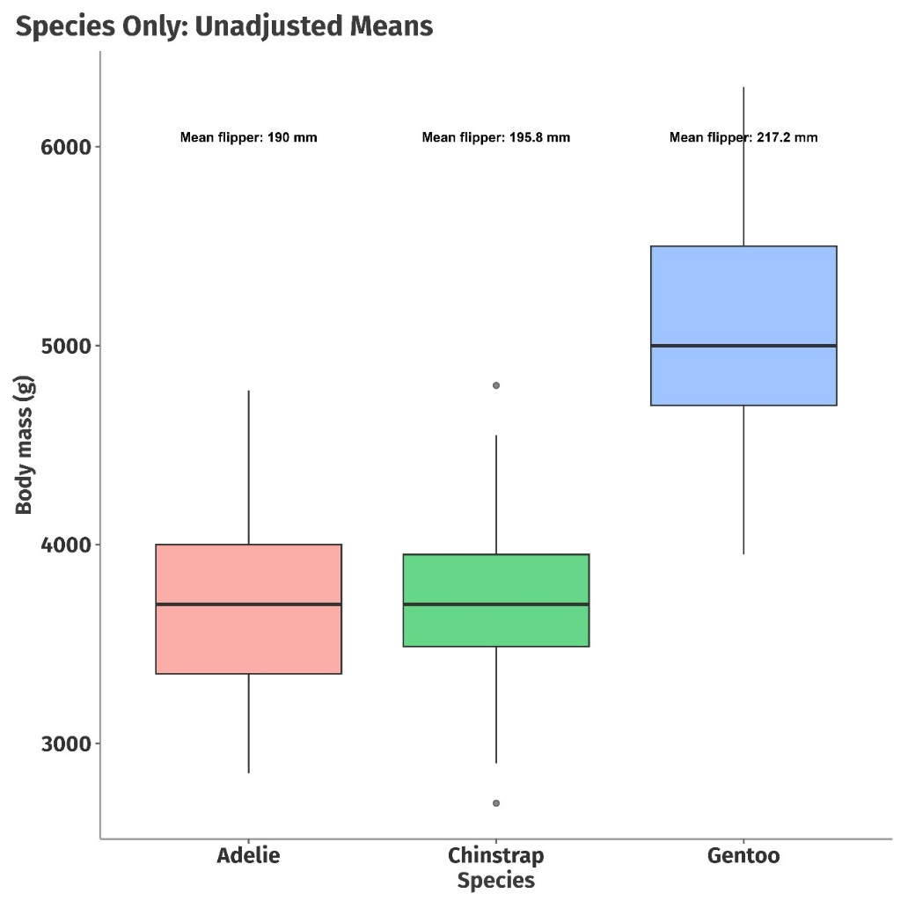
Does Species predict Body mass of palmer penguins?
We want to know if each species of penguins differ in their body weights and if so, how much?
There could be lot many other aspects that determines body weight which is beyond

Slide 4
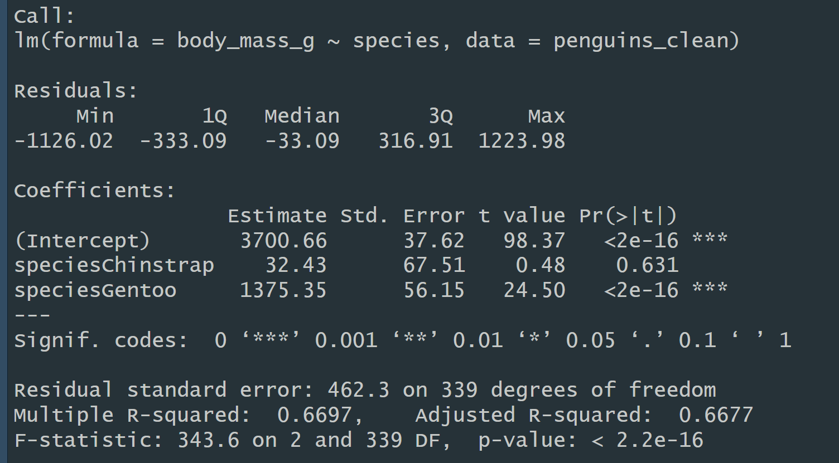
Mean body mass for Adelie penguins (the reference species)
Chinstraps are, on average, about 32 g heavier than Adelies - but the p-value (0.631) says this difference is not statistically significant
Gentoos are on average 1,375 g heavier than Adelies, and the difference is highly significant
A very important thing to understand is that the estimates for the other categories are presented relative to the reference level
So now, can we say this is a good model?

Slide 5
Does Species predict Body mass of palmer penguins?
We want to know if each species of penguins differ in their body weights and if so, how much?
There could be lot many other aspects that determines body weight which is beyond

Slide 6
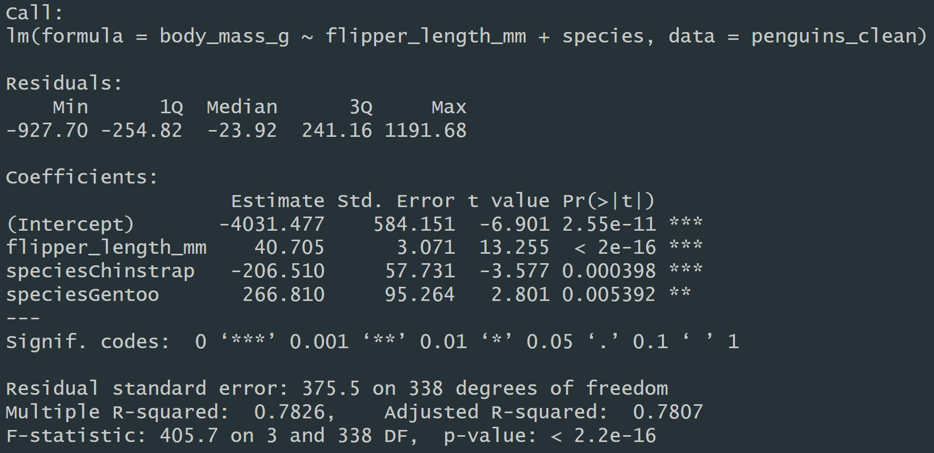
Expected body mass for an Adelie with flipper length 0 mm
For each 1 mm increase in flipper length, body mass increases by about 40.7 g, holding species constant
Chinstraps are about 207 g lighter than Adelies with the same flipper length.
Note: In the species-only model, Chinstraps were heavier (+32 g) than Adelies,but here they’re lighter.
That’s because flipper length was a confounder
Chinstraps have longer flippers, which inflated their mean mass when flipper length wasn’t accounted for
Gentoos are about 267 g heavier than Adelies with the same flipper length
In the species-only model, Gentoos were +1,375 g heavier
Adding flipper length explains most of that difference

Slide 7
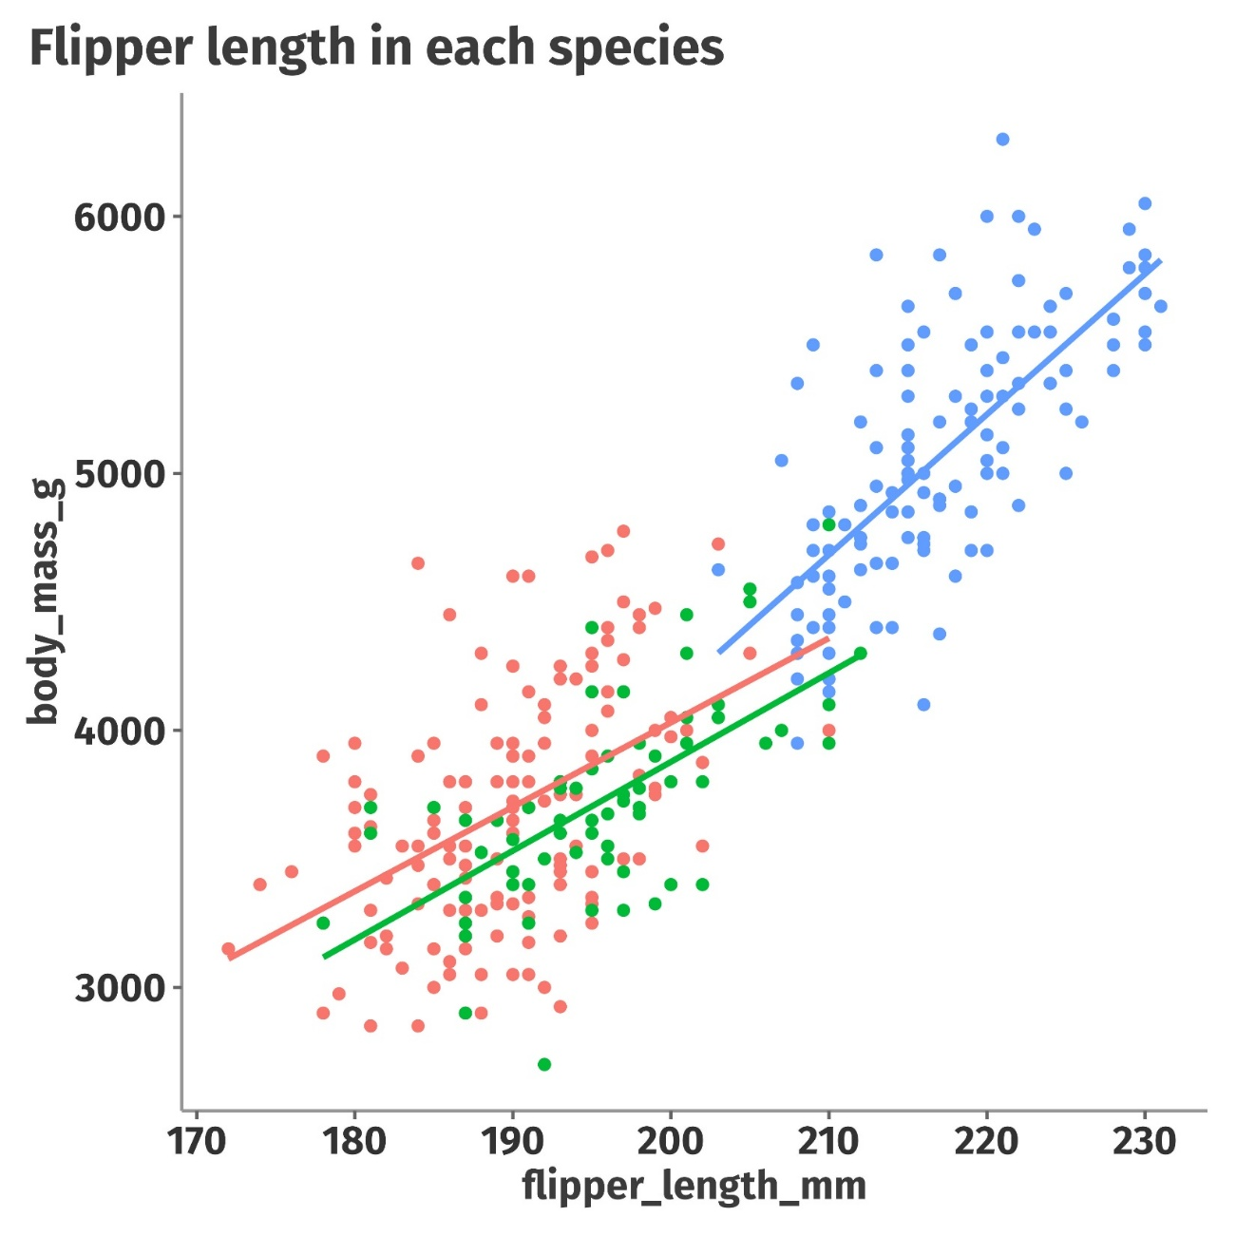
Should we bother about flipper length as well?

Slide 8
Assumptions

